Slide 1

Machine Learning for Streamlining Loan Approval or Rejection Processes through Predictive Analysis

Slide 2
Problem Statement
The objective of this project is to develop a predictive model that accurately determines the likelihood of a loan application being approved or rejected. This model is trained on a comprehensive dataset containing historical loan application records. Each record includes details such as the applicant's number of dependents, education level, employment status, annual income, loan amount requested, loan term, CIBIL score, and the value of various assets owned (residential, commercial, and luxury).
By analyzing these attributes, the model aims to identify patterns and relationships that significantly influence the loan approval decision. The ultimate goal is to optimize the decision-making process, ensuring that loan applications are evaluated more quickly, impartially, and accurately, thereby reducing the risk of default and enabling financial institutions to make more informed lending decisions.

Slide 3
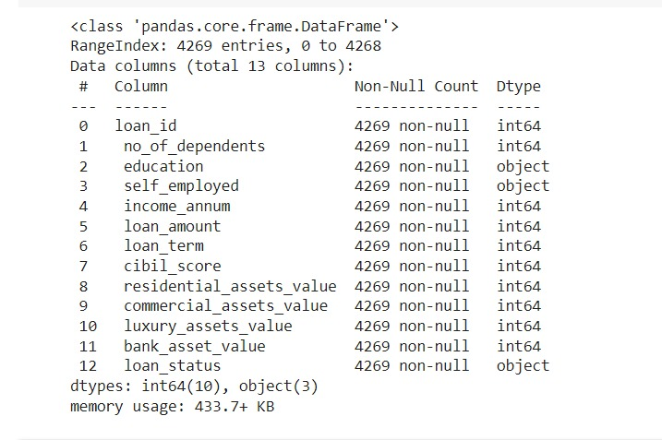
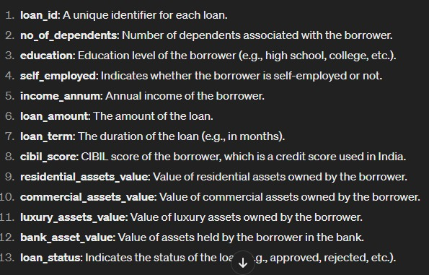
DATA
DESCRIPTION
The dataset contains a comprehensive collection of 4,269 loan application entries. Each entry is detailed with 13 distinct features that encompass both numerical and categorical types of data. These features include critical applicant information used for analyzing the loan approval decision.

Slide 4
Model Selection
LogisticRegression
KNeighborsClassifier
GradientBoostingClassifier
SVC

Slide 5
The dataset involves predicting discrete outcomes, whether a loan application will be approved or denied, which aligns with the nature of classification tasks. We therefore select between:
Each classification model has its own advantages and disadvantages. Logistic Regression is simple but assumes linear relationships. KNeighborsClassifier is flexible but can be sensitive to noise. GradientBoostingClassifier provides high accuracy but may overfit if NOT carefully tuned. SVC effectively separates classes but may need careful preprocessing to give good results.

Slide 6
Best Model : GradientBoostingClassifier
Best Cross-Validation Train Score: 0.99
This indicates that the model achieved a high level of accuracy (99%) on the training data during cross-validation. It suggests that the model effectively learned the patterns in the training data.
Best Cross-Validation Test Score: 0.97
The model also performed exceptionally well on unseen data, achieving a cross-validation accuracy of 97%. This suggests that the model has good generalization capability and is not overfitting to the training data.
Test-Set Score: 0.98
The accuracy of 98% on the test set further validates the model's performance. It indicates that the model maintains high accuracy when applied to completely unseen data, reinforcing confidence in its effectiveness

Slide 7
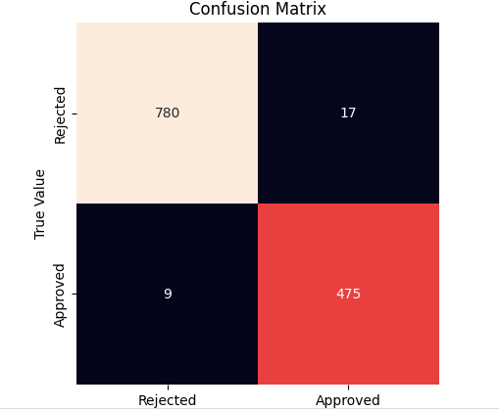
Accuracy indicates the overall correctness of the model's predictions.
In this case, the accuracy can be calculated as (780 + 475) / (780 + 475 + 17 + 9) = 0.979, or 97.9%.
Precision highlights the proportion of positive predictions (e.g., loan approvals) that are correct, minimizing the number of false positive predictions.
Precision here would be 475 / (475 + 17) = 0.965, or 96.5%.
Recall (98.1%) measures the model's ability to correctly identify all positive instances (e.g., actual loan approvals), minimizing the number of false negative predictions.
Recall in this case would be 475 / (475 + 9) = 0.981, or 98.1%.

Slide 8

Insights
The high accuracy, precision, and recall scores suggest that the model is effective in predicting loan outcomes.
For financial institutions, accurate prediction of loan approvals and rejections is crucial for risk assessment and decision-making.
A model with high precision minimizes the risk of approving loans that may default, while a high recall ensures that a large proportion of potential loan approvals are correctly identified.
With these results, the financial institution can make informed decisions regarding loan approvals, potentially reducing financial risks and improving operational efficiency.
Additionally, the model's performance metrics provide insights into areas for potential improvement or refinement, such as addressing imbalances in precision and recall or exploring additional features to enhance predictive accuracy.

